Slide 1
2021-2022 Public Hearing on Budget
Westfield Public Schools A Tradition of Excellence
Dr. Margaret Dolan, Superintendent
Dana Sullivan, Business Administrator
April 27, 2021

Slide 2
Budget Calendar
DAY DATE AGENDA
Friday November 18 Budget forms distributed to schools
Tuesday December 8 Public Board Meeting/Board Workshop
Budget discussion
Friday December 11 Budget documents returned to business
office and school/department budgets
entered into CSI (budget software)
December thru January Superintendent and Business Administrator meet with every Principal/Department Head to review budget requests
Tuesday February 23 Public Board Meeting – Budget
Presentation
Thursday February 25 Receipt of state aid
Tuesday March 16 Public Board Meeting – Budget
Presentation - Adoption of Tentative Budget
Monday March 22 Budget Due to County Office
Thursday April 22 Advertisement for Public Hearing
appears in Westfield Leader
Tuesday April 27 Public Hearing on Budget-
Adoption of Final Budget
All meetings will be held at 7:00 pm via the Webex online platform, unless otherwise indicated.
Notes:
Board Workshop September 23, 2014
Goal Setting by Committees

Slide 3
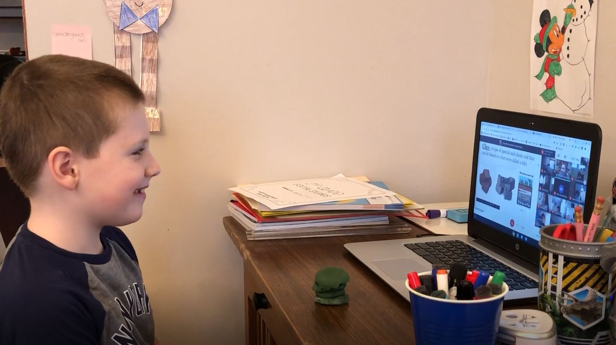
Budgetary Goals
Maintain class sizes within policy guidelines
Maintain funding for:
Recently approved courses
School Resource Officers
Maintain fund balance at 2%
Stay within 2% CAP
plus eligible waivers
Assess 1:1 Chromebook Initiative
Ensure compliance with CDC and DOE guidelines
Determine if reallocation funds is possible as a result of remote learning

Slide 4
Estimated Tax Impact
Budget is at state mandated tax levy CAP
Tax rate increase is 1.66%
Increase to average homeowner is approximately $170

Slide 5
Sources of Revenue 2021-2022 Operating Budget (Without reserve accounts)

Slide 6
State Aid 2020-21 and 2021-22
Category | Aid 2020-21 | Aid 2021-22 | Increase/(Decrease)
Transportation | $ 575,681 | $ 575,681 | $0
Special Education | $3,497,975 | $4,501,010 | $1,003,035
Security | $ 437,833 | $ 437,833 | $0
Total Basic State Aid | $4,511,489 | $5,514,524 | $1,003,035
Extraordinary | $ 975,000 | $ 975,000 | $0
Total State Aid Operating Budget | $5,486,489 | $6,489,524 | $1,003,035
Debt Service | $ 833,695 | $ 838,234 | $ 4,539

Slide 8
Enrollment Growth District Wide Historical Perspective
Notes:
For the last 5 years or so enrollment in the district has remained stable, however, as you can see by this chart, enrollment in the last 20 years or more has increased significantly.

Slide 9
How the Operating Budget is Spent 2021-2022

Slide 10
Total Staffing 2021-2022

Slide 11
Westfield Public Schools Cost Per Pupil Westfield Compared to Similar School Districts

Slide 12
Westfield Public Schools Cost Per Pupil - Percentage of Instruction Westfield Compared to Similar School Districts

Slide 13
Cost Containment
Self Insured Medical and RX Plans
Coordinated Transportation to Out-of-District Placements
Cooperative Purchasing
Solar Panels on Five Schools
Shared Services with Town of Westfield
In-District Special Education Programs

Slide 14
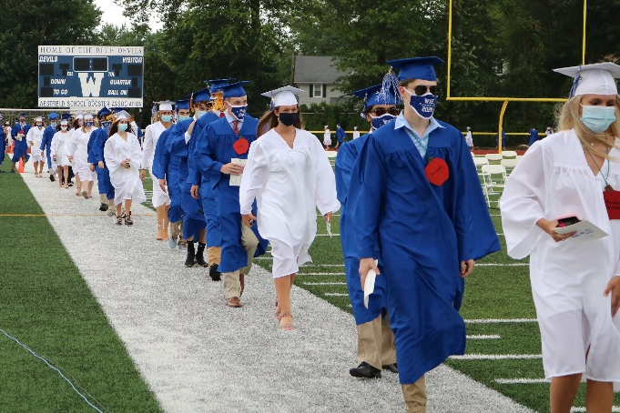
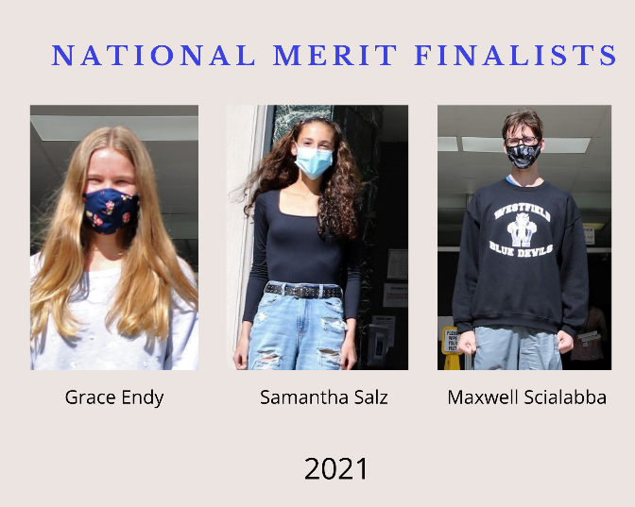
Student Accomplishments
94% of WHS Graduates (Class of 2020) Continued on to Higher Education
3 National Merit Finalists (2021) &
9 National Merit Commended Students
National African American Scholar & National Hispanic Scholar (2020-2021)

Slide 15
Student Accomplishments
257 WHS Students Invited into National Honor Society
Students Achieve Perfect Scores on SAT Subject Tests
Fine Arts Students Recognized at Regional, State, and National Levels
Student Athletes Excel at County, State, and National Levels.

Slide 16
MISSION
The Westfield Public School District, in partnership with families and the community, educates all students to reach their highest potential as productive, well-balanced and responsible citizens who respect individual differences and diversity in an ever changing world.

